Slide 1
Graphical User Interface – Part2

Slide 2
Setting default window and font size
from tkinter import Tk, Label root = Tk() root.geometry('1048x700') custom_font = ('Times New Roman', 28) root.option_add("*Font", custom_font) l = Label(root,text="Hello World") l.pack() root.mainloop()

Slide 3
place() method
from tkinter import Tk, Label root = Tk() label_1 = Label(master=root, text='Hello') label_2 = Label(master=root, text='World') label_1.place(x=100, y=10) label_2.place(relx=.5,rely=.5) root.mainloop()

Slide 4
Placing Widgets
pack() vs grid() vs place()

Slide 5
Binding events – KeyPress
from tkinter import Tk, Text def record(event): print(f'Key={event.keysym}') root = Tk() txt = Text(master=root, height=3, width=20) #Bind Event txt.bind('<KeyPress>', record) txt.pack() root.mainloop()
text.bind('<KeyPress>', record)

Slide 6
Binding events – Mouse Motion
from tkinter import Tk, Text, END
def record(event): text.delete(1.0,END) text.insert(END,f"Mouse is at ({event.x},{event.y})")
root = Tk() text = Text(master=root, height=10, width=50,font=('Arial',24)) text.pack() text.bind('<Motion>',record) root.mainloop()
text.bind(‘<Motion>', record)

Slide 7
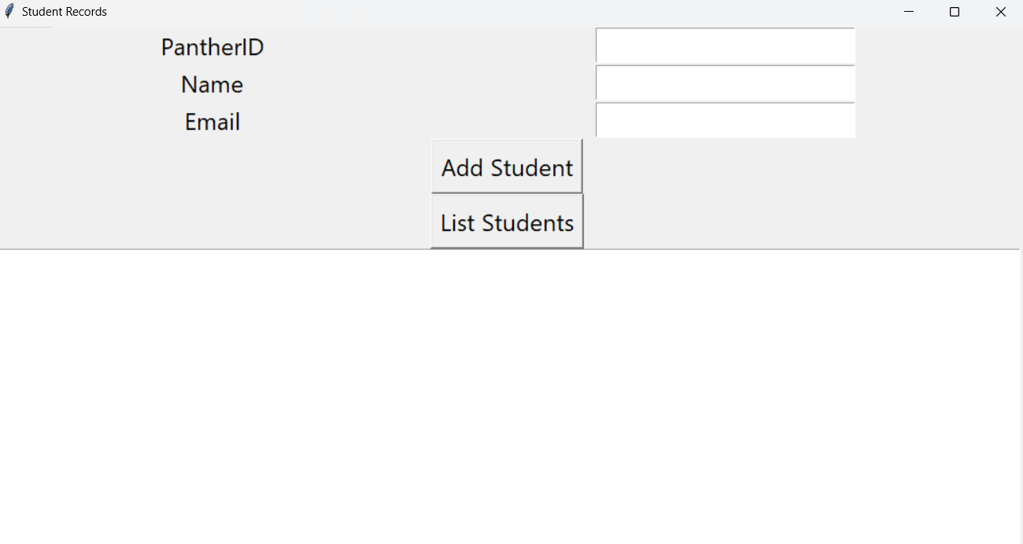
Building a Simple GUI Application
Student Records App

Slide 8
Title
Labels
Entry
Button
Text
Student Records App – Frontend / User Interface

Slide 9
Student Records App
Required tkinter widgets:
Labels – 3 (To display the text)
Entries – 3 (To take inputs from user)
Buttons – 2 (To add and display student records)
Text – 1 (To display student records)

Slide 10
Student Records App – Storing Data
To save Student Records to a csv file:
student_records.csv
Example:
PantherID | Name | Email
001 | A B | ab@student.gsu.edu
002 | C D | cd@student.gsu.edu

Slide 11

Events
Add Student
-Obtain the PantherID, Name, and Email from GUI
-Insert a row in ‘student_records.csv’
-clear the entries for user friendliness
add_student()
List Students
-Clear the Text widget
-Obtain the student records from Database
-Display the records in the Text widget
list_student()

Slide 12
Student Records App – Source Code
iCollege > Content > Coding Demo > student_record_app.py

Slide 13
Attendance

